Slide 1
Project Phase One
By: Ryan Cooley

Slide 2
Loading the Data and Resources
To start any data analytics is to load our data and upload the tools also known as libraries to do so.
In Posit we first install the packages we are using which are massive groups of tools and then also individually library the tools we want to use from those packages.
Next using our preferred tools from which we just installed we would upload the data we are analyzing into the software. In this case I used tidyverse.

Slide 3
Data Cleaning
Now that I can access the data, we need to go through it and see how it is formatted and if there are any redundant or not important inputs.
In this case there were three variables which were not needed so I removed them from the dataset.
Furthermore, while analyzing the type of data, I saw that four variables had data classified as numeric when it should have been categorical. This means it was considered a number when it should have been considered as a group.
To solve this issue, we can simply change the format through one line of code

Slide 4
Data Prep
The last couple steps before we can begin analyzing the data is to recode or change how the groups are classified and to then check to see if there is any missing data.
In this case we had three variables whose inputs were classified as 0 and 1 to signify no and yes so, we simply changed it to say no or yes for easier manipulation and readability.
When it comes to missing data, there was none in this data set so we can just move on.
Outliers are important to consider and thankfully in our data set we had no obvious outliers.
The last step is to split the data we have into training and testing which means we have 70% of our data to build the model on and then we can test how accurate our model is on the other 30%.

Slide 5
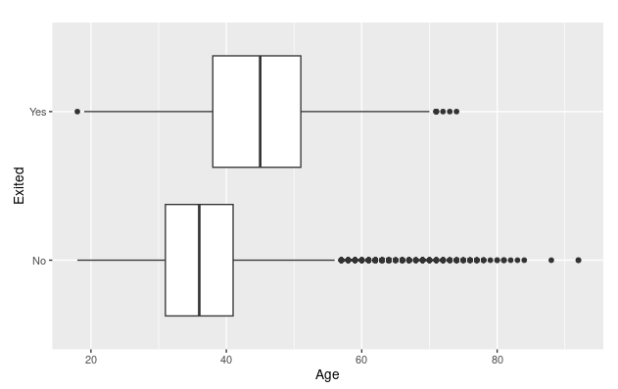
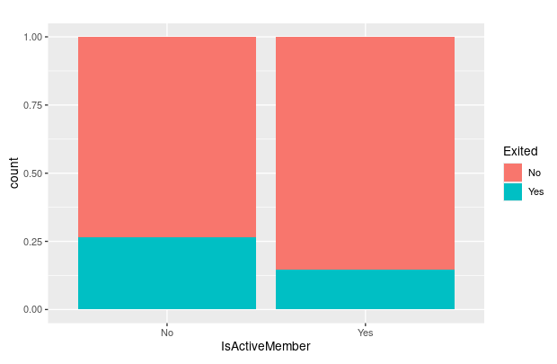
Data Analysis Part 1
Before we can build a model, we must know what variables are important and which ones are not. There are a couple ways to do this, but the best one is to graph each variable with the response variable. The response variable is the variable we are trying to understand and model.
To do this I created ten different graphs comparing all the other variables with Exited which is the response variable.
There are two types a box plot for numeric and a filled bar chart for the factors.
Box Plot
Filled Bar Chart

Slide 6
Data Analysis Part 2
From the visualizations I can see that the main dependent variables are Age, Balance, NumOfProducts, Geography, Gender and IsActiveMember. To further narrow it down i would start building models and comparing the accuracy levels.
Though the three that weigh the most are Age, NumOfProducts and IsActiveMember.
Overall, the dependent variables can be sorted into type of customer meaning age, gender and economic class, along with the location and how many services they are using seems to be the three main categories that impact Exited.

